Slide 1
Energy modelling with TIMES
Slides by Uwe Remme, IEA, adapted for ERC by Bruno Merven
September 2016

Slide 2
Content
Overview of TIMES
The Core equations
Building blocks of a TIMES model
Solving the TIMES model using LP/MIP

Slide 3
TIMES
Methodology
Bottom-up Model
Perfect competition
Perfect foresight (or myopic)
Optimization (LP/MIP/NLP)
Development
By ETSAP (Energy Technology Systems Analysis Program; www.iea-etsap.org)
Implementation in GAMS
Model generator
Two software interfaces available: ANSWER-TIMES and VEDA-FE
Min/Max Objective function
s.t.
Equations, Constraints
Decision Variables <=> Solution
Input parameters
Advanced Features/Variants
Multi-regional
Vintaging
Elastic demands
Endogeneous learning
Discrete capacity expansion
Early retirement of capacity
Macroeconomic linkage
Climate extension
Stochastic programming
Alternative objective functions
Multi-criteria optimization
TIMES
(The Integrated MARKAL
EFOM System)

Slide 4
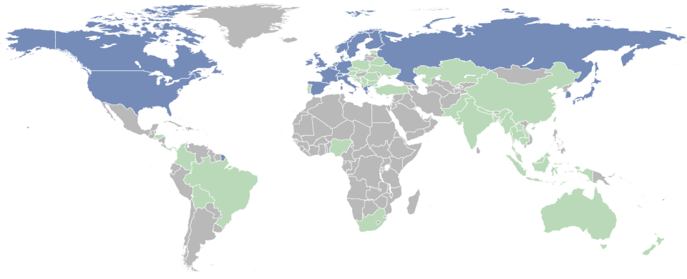
Applications of MARKAL/TIMES around the world
Contracting parties
Model users
Used by more than 150 institutions in 63 countries

Slide 5
Core Equations of a TIMES model

Slide 6
TIMES Basic model constraints based on fundamental principles
Principle
TIMES equivalent
Decision variables
Energy conservation
Commodity balance
Flow variables
Energy conversion
Transformation equation
Activity variables
Flows through technology limited by available capacity
Capacity-utilisation constraint
New capacity variables
Objective function:
Minimise system costs
Cost coefficients of decision variables

Slide 7
Basic equations
EQ(l)_COMBAL _{r,t,c,s} Commodity balance
EQ_ACTFLO _{r,v,t,p,s} Definition of activity variable
EQ_CAPACT _{r,v,t,p,s} Utilization constraint
EQ_PTRANS _{r,v,t,p,cg1,cg2,s} Transformation equation
EQ_OBJ Objective function

Slide 8
Commodity balance equation
COM
Commodity type MATerial, FINancial
=
≥
Commodity type NRG, ENV, DEM
Imports
VAR_IRE
Exports
VAR_IRE
Consumption
VAR_FLO
Consumption
Production
VAR_FLO
Production
Output storage
VAR_SOUT
Input storage
VAR_SIN
Projected demand
COM_PROJ(r,t,c)
Capacity related commodity flows
NCAP_COM(r,v,p,com,‘out‘) x VAR_CAP
Capacity related commodity flows
NCAP_COM(r,v,p,com,‘in‘) x VAR_CAP
Auxiliary emission of exchange process
IRE_FLOSUM x VAR_IRE
Auxiliary production of exchange process
IRE_FLOSUM x VAR_IRE
Commodity released at decommissioning
NCAP_OCOM(r,t,p,c) x VAR_NCAP
Commodity required at investment
NCAP_ICOM(r,v,p,c) x VAR_NCAP

Slide 9
Definition of activity variable
Activity variable VAR_ACT measures generation of the technology.
In most cases one of the energy output flows; for power plants activity equals the electricity output flow
COL
ELC
CO₂
Flows
Supercrititcal
coal plant (SCP)

Slide 10
Capacity utilization constraint
EQ(l)_CAPACT _{r,v,t,p,s}
≤
=
VAR_ACT(r,v,t,p,s)
Available capacity of process p in period t and timeslice s
Capacity:
Past investments before model horizon
New capacity built in previous periods
New capacity built in current period t
Activity of process
Three availabilities:
NCAP_AFA(r,v,p,l) : Annual availability
NCAP_AFS(r,v,p,s,l) : Seasonal availability
NCAP_AF(r,v,p,s,l) : Availability for individual timeslices
which can be combined.

Slide 11
Transformation equation
Transformation equations establishes relationship between the input and output flow.
GAS
ELC
VAR_FLO_{ELC}
Gas power plant
EGASCC0
VAR_FLO_{GAS}
Overall efficiency from input to output
Transformation equation

Slide 12
Objective function
Objective function = total discounted energy system costs over the entire model horizon
Typical cost components in the objective function:
Variable O&M costs in period t
Fixed O&M costs in period t
Levelized investment costs in period t (capital recovery factor crf depends on economic lifetime and/or technology specific discount rate)
Costs/Revenues from imports/exports in period t
Costs in real terms
General discount rate used to discount costs from different periods to base year
Investment costs spread over construction time to mimick interest cost during construction

Slide 13
Further model equations
Description of exchange processes in multi-regional models
Elastic demands
Product/market share constraints, e.g. share of hydrogen cars in total person kilometer demand
Peaking equation: Ensures enough available firm capacity during peak demand
Storage equation: Modeling of storage between timeslices (e.g. pump storage) or between periods (e.g. stockpiling)
Commodity-specific availabilities, e.g. full load hours of CHP plant in backpressure and condensing mode
User constraints: Flexible framework to formulate constraints being not part of the standard portfolio of TIMES equations, e.g. growth constraints, renewable quota

Slide 14
Building Blocks of TIMES model

Slide 15
TIMES model components
Made up of 2 simple components:
1. Energy Carriers (e.g. fuels, demand)
2. Technologies (e.g. Light bulb, power plant) all characterized in the same way:
Input and Output Carriers
Efficiency
Investment Costs per unit of capacity
Activity Costs
Existing Capacity
Annual Availability
Expected Life
Emissions

Slide 16
Technology representation
Commodities
Process
Coal PC Supercrit. | Unit | 2005 | 2010 | 2020 | 2030
Size | MW_{el} | 600 | 600 | 600 | 600
Construction time | Years | 3 | 3 | 3 | 3
Lifetime | Years | 35 | 35 | 35 | 35
Efficiency (LHV) | % | 46 | 47 | 48 | 50
Max. availability | h/a | 7500 | 7500 | 7500 | 7500
Spec. Investment costs (overnight) | €/kW_{el} | 1175 | 1175 | 1140 | 1140
Fixed O&M | €/(kW a) | 40.5 | 40.5 | 40.5 | 40.5
Var. O&M | €/MWh_{el} | 2.6 | 2.6 | 2.6 | 2.6
Coal
Electricity
CO₂
Flows
Flows
Supercrititcal
coal plant (SCP)
0.736 kg
2.2 kWh
0.27 kg_{SKE}
1 kWh
Efficiency eqn
Emission eqn
Input parameter
Activity definition
Plant efficiency
CO2 Emission factor
Annual availability
Utilization eqn

Slide 17
Horizontal dimension of the RES: technology chains
Electricity LV
Coal, washed
Coal, power
Electricity HV
Electricity MV
CO₂
Appliances
Coal
imports
Lighting
Coal
transport
Grid MV &
Transf.
Supercritical
coal plant
Urban trains
Domestic
mining
Grid HV &
Transf.
Industry
Backward Loops

Slide 18
Vertical dimension of the RES: competition
Coal, washed
Coal, power
Electricity HV
Electricity MV
CO₂
Appliances
Domestic
mining
Supercritical
coal plant (exst)
Lighting
Coal
transport
Grid MV &
Transf.
Ultrasupercritical
coal plant (new)
Urban trains
Coal
imports
Grid HV &
Transf.
Natural gas
Industry
Natural gas
GT (exist)
Natural gas
CC (new)
Competing options to produce
electricity:
between technologies
between old and new plants
Influenced by:
Technology costs
Efficiencies
Emission factors
Fuel prices…
Lignite
Supercritical
lignite plant (exst)
Supercritical
lignite plant (new)

Slide 19
Solving the TIMES model

Slide 20
Linear programming (LP) model
Decision variables (positve, continuous):
Activity variables (Production level of technologies)
Energy flows
Investment decisions
Optimization problem
Objective function
Min
Model constraints
(linear constraints):
Energy/ emission balances
Efficiency relationships
Utilization constraints
Peaking eqn (reserve capacity)
GHG mitigation targets, quota for renewables,…
Standard TIMES model: Linear programming
Implemented in modeling environment GAMS (General Algebraic Modeling System) for optimization/equilibrium problems
Solution by interior point solvers (CPLEX, XPRESS)
Variants of TIMES:
Macro economic module -> Non-linear eqns -> Non-linear programming
Block-wise capacity expansion -> Binary variables -> Mixed-integer programming

Slide 21
ANSWER interface

Slide 22
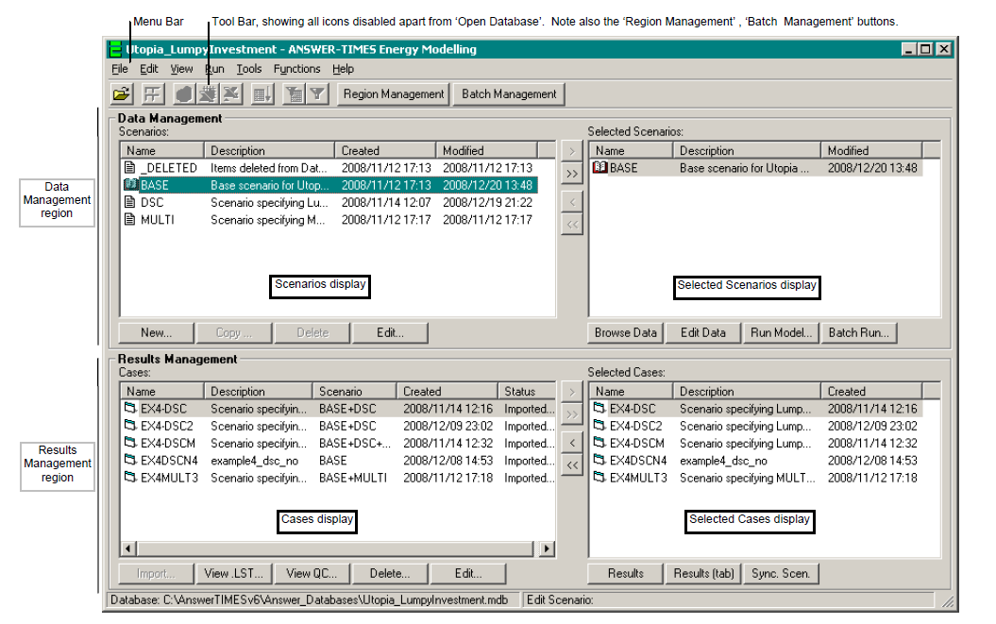
ANSWER-TIMES: Model interface

Slide 23
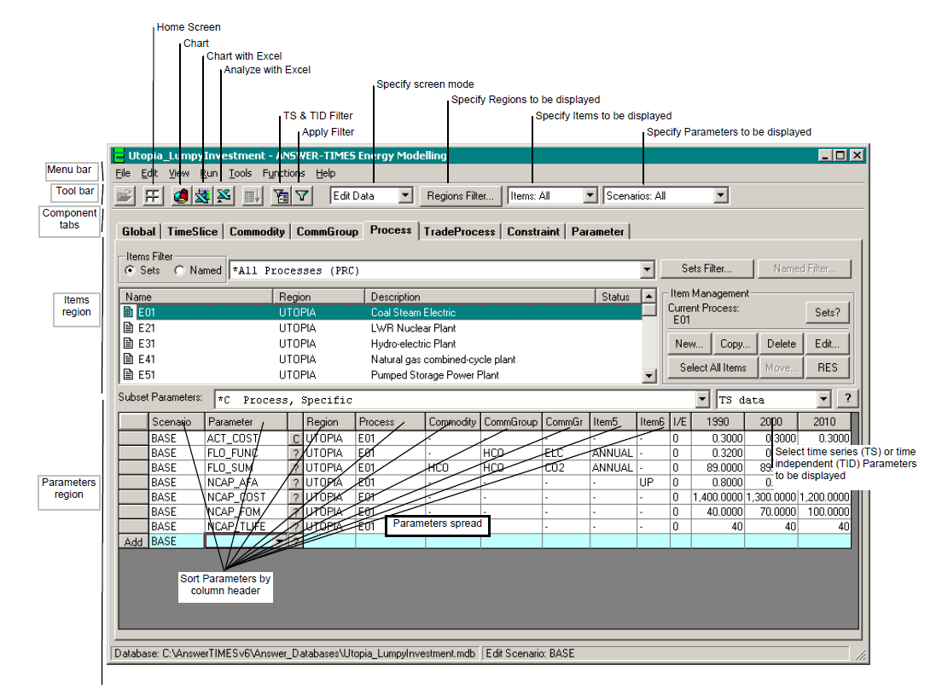
ANSWER-TIMES: Data and results screen

Slide 24
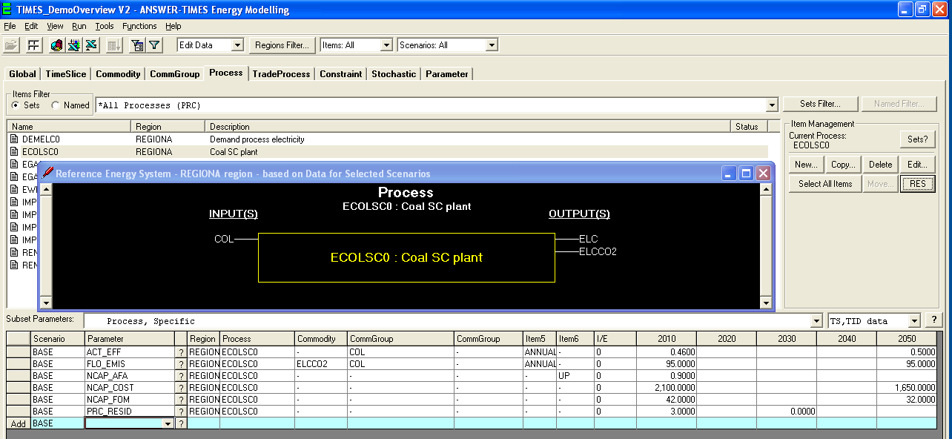
ANSWER-TIMES: RES navigation

Slide 25
TIMES Installation: 4 Steps
Vula Resources: TIMES – GAMS folder
Install TIMES:in the Answer_TimesSetup_6.7.8 folder:
Run “setupAnswerTimes6.7.8.exe”
Install GAMS:in the TIMES – GAMS folder
Run either: GAMS_windows_x86_32 or GAMSsetupWinx64_64.exe
Copy Licenses: in the Licenses folder
TIMES: unzip answerTIMESv6_Course2014Aug.zm9 into C:\AnswerTIMESv6
GAMS: copy gamslice.txt file into GAMS folder
Add GAMS folder to path:
Choose Start, Control Panel, and then choose System and Security. Click on the “System” option and then click on the “Advanced system settings” option. This will bring up the System dialogue box, with the Advanced tab selected. Click on the Environment Variables button at the lower right. Scroll down in the System variables list until you find Path, select Path and then click on the Edit button to bring up the Edit System Variable form. (If you find that the Edit button is disabled, ask your system administrator to change the Path for you.) Then if your GAMS installation directory is say C:\Program Files\GAMS23.3, add the following to the end of what is currently displayed as the Value of Path:
;C:\”Program Files\GAMS23.3”
Note that there must not be any intervening space between the last character of the current Path and the semicolon, and also the drive letter (C) must be capital. Click on the OK button to confirm the new Path. Reboot the PC so that the new Path takes effect.

Slide 26
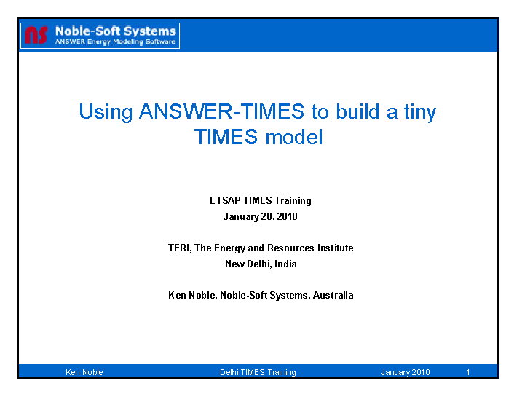
Tiny TIMES model: pdf file in TIMES – GAMS folder

